Slide 1
Code Innovation Series BY INCUBATE IND
PROTOTYPE PRESENTATION

Slide 2
TEAM : DARTH VADER
MEMBERS : ANKIT KUMAR (1805279@kiit.ac.in)
DIVYANSH SINGH (singh.divyansh1802@gmail.com)
THEME : EDUCATION

Slide 3
PROBLEM STATEMENT
Create solutions to deal with these changes faced by the users :
Transforming Dull Subject Matter Into Amazing e-learning Experiences
Lack Of Learner Motivation And Engagement
Staying Up-To-Date With Modern Tech
Designing e-learning Courses For Different Generations
Measurable learning outcomes
Adaptive learner models to accommodate different learner needs.

Slide 4
OBJECTIVES OF THE PROJECT
An inbuilt discussion forum that will help users to communicate and help each other grow.
This platform will provide you with badges according to your expertises and hence also a leaderboard to know where you stand.
This platform will also have a blogging section where one can know all about recent techs and tools that are being used to keep themselves updated.
There will also be a video content library that would be of great help for the users who are confused from where and how to start.
This platform will also have a dedicated dynamic test portal through which you will be getting your badges and according to which other courses would be recommended.

Slide 5
TECHNOLOGY PLATFORM
Frontend : HTML , CSS , Javascript
Library : JQuery
Backend : PHP
PHP is used in backend because of its simplicity and large scale usability, efficient performance
Database : MySQL
Mysql is most widely used relational database because of its security and high performance

Slide 6
SCALABILITY : This platform can be further extended for a university in guiding them. EFFECTIVENESS : This platform can be easily implemented for personal as well as for commercial use . It will motivate learner to constantly improve their skill set according to the market demand and also it will create a healthy competition among the learner .
ASSUMPTIONS : It is assumed that the tests attempted by user are given with complete dedication and without use of any unfair means.

Slide 7
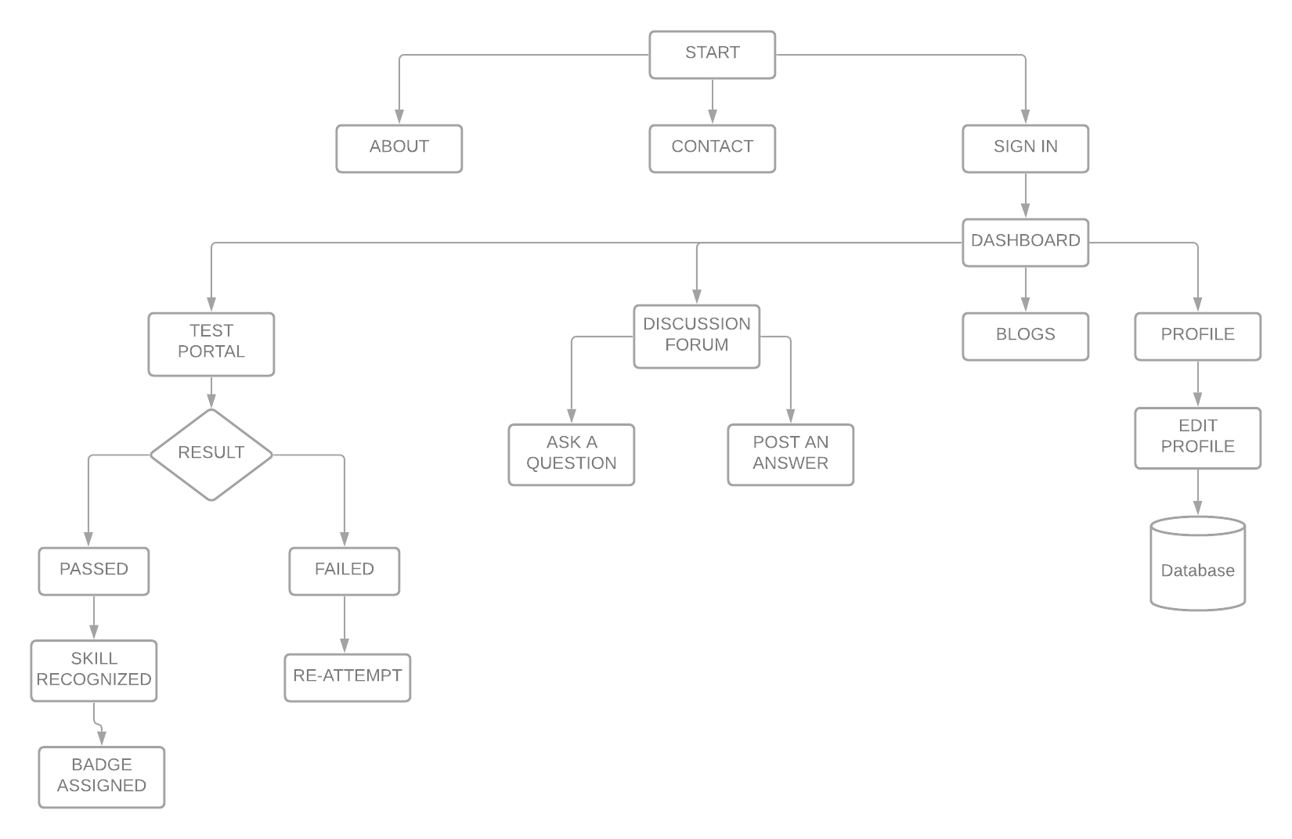
FLOWCHART

Slide 8
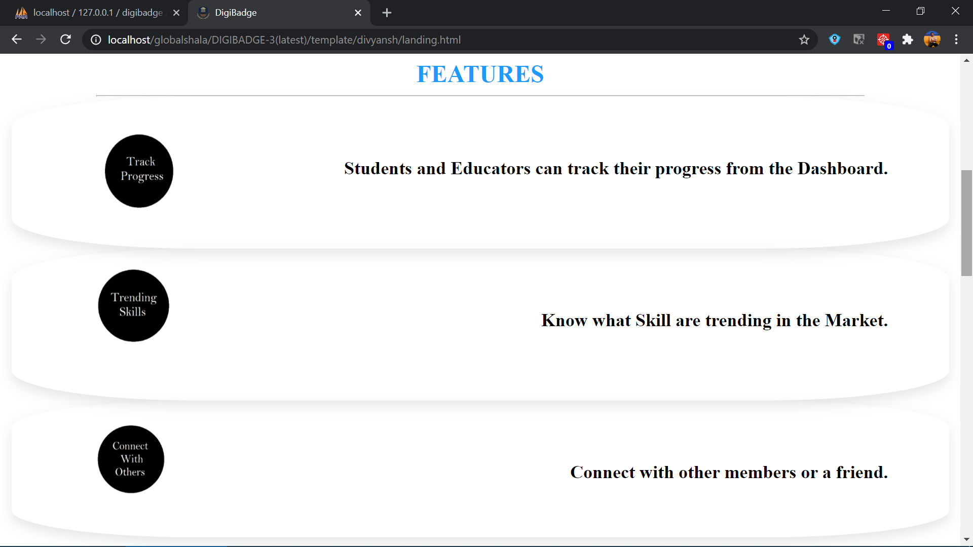
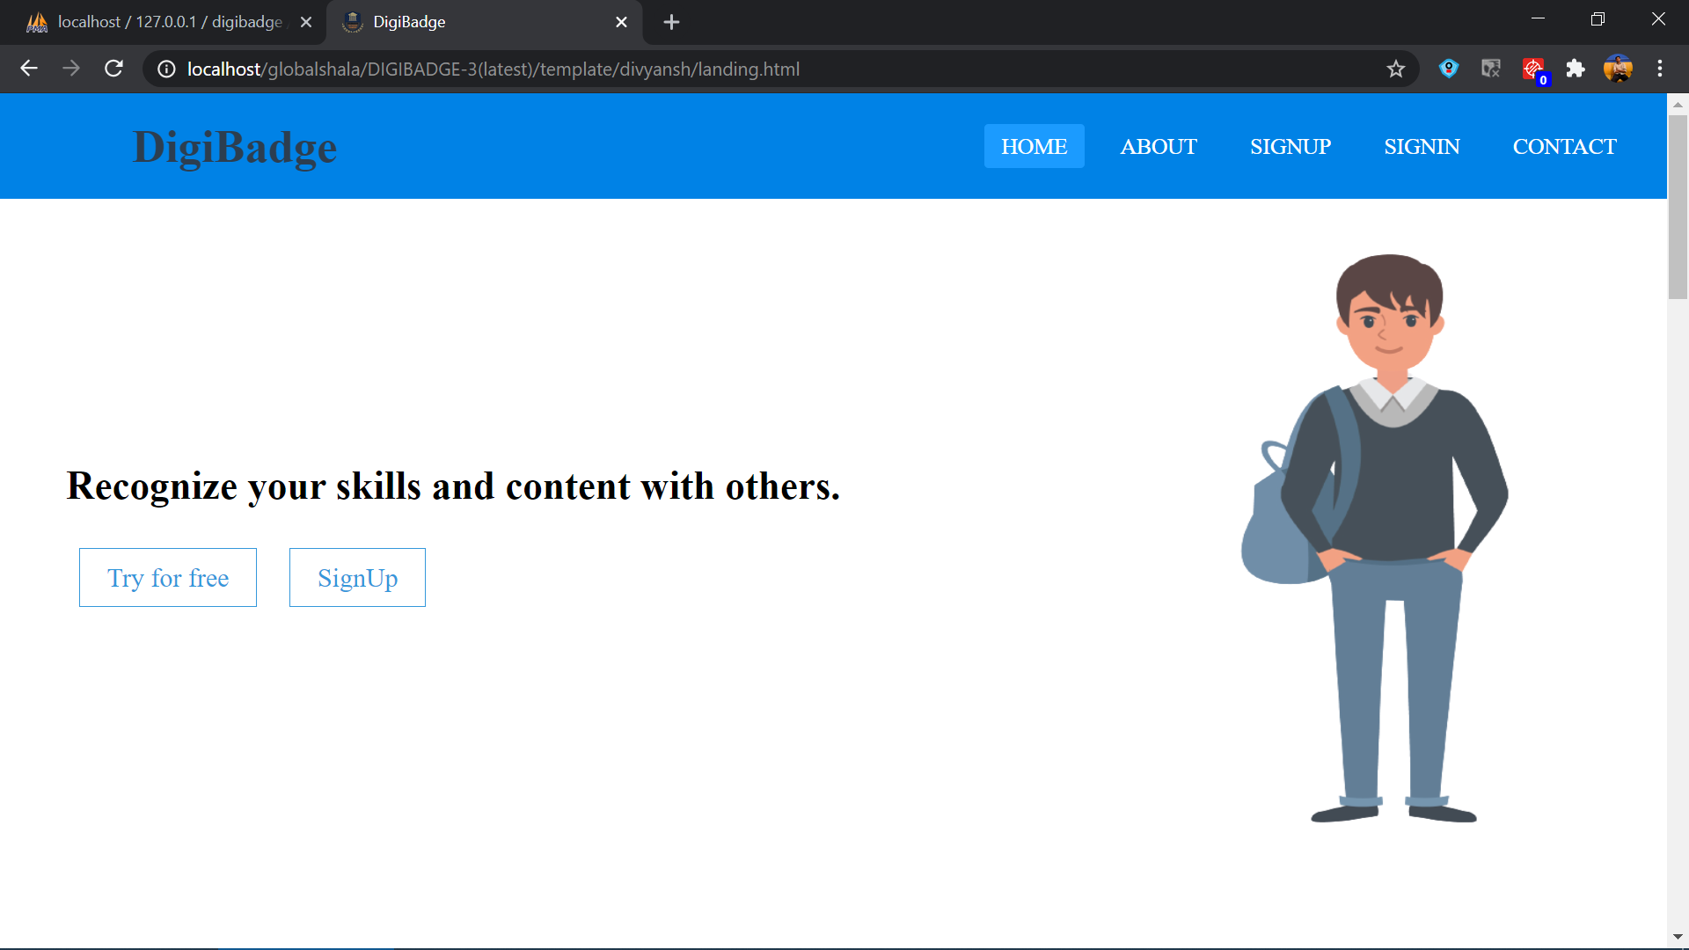
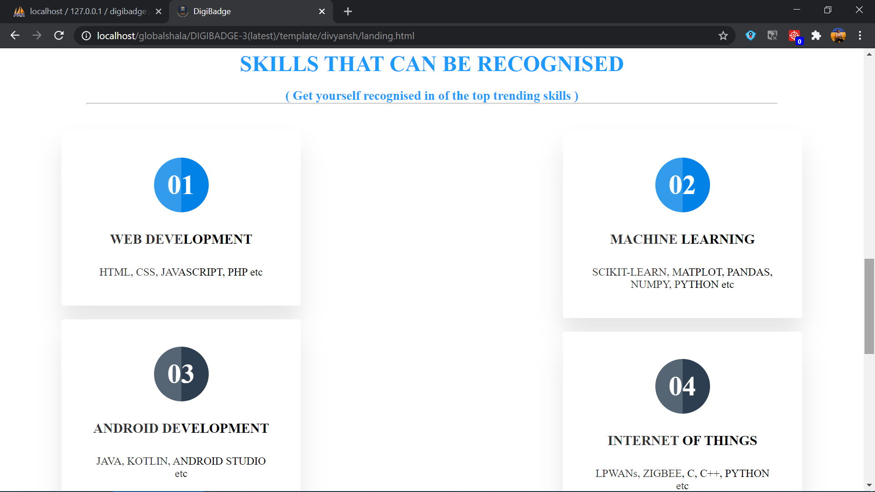
PROTOTYPE SCREENSHOTS

Slide 9
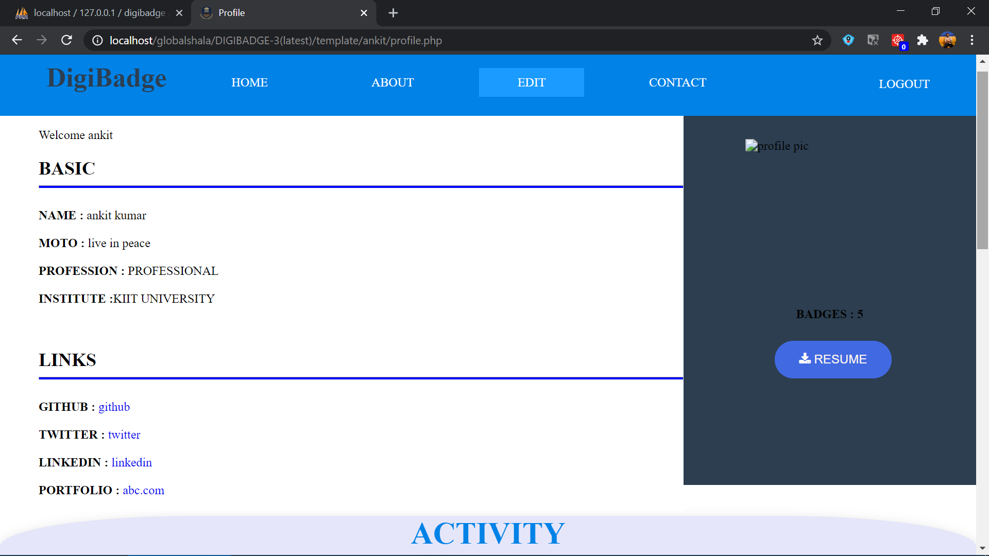
PROFILE PAGE
The first scrolling page of Profile Page Section will contain basic details of the user along with some of his links he wants to portray and a download button to download his Resume.

Slide 10
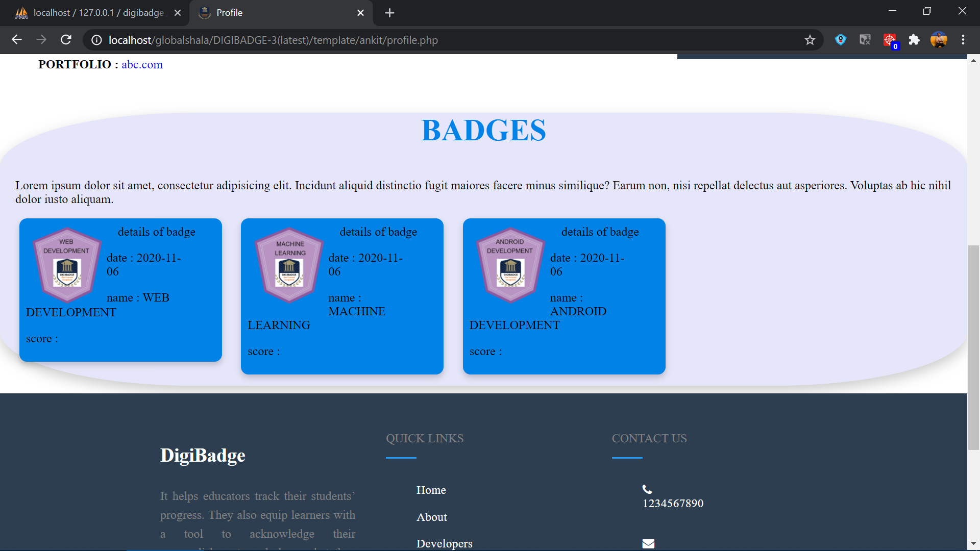
PROFILE PAGE - (BADGES)
The second scrolling page of the user profile page give us the info about how active he is i.e., number of new technologies the user learns in a given frame of time in a pie chart representation.

Slide 11
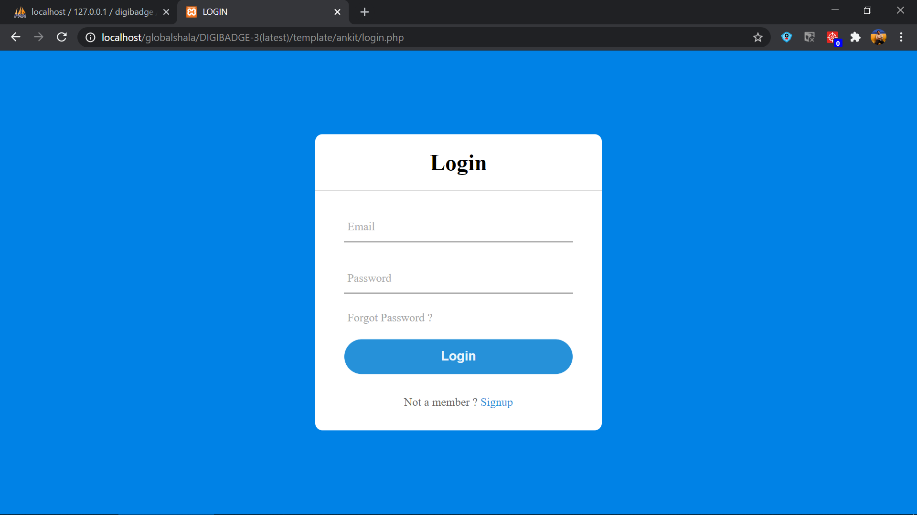
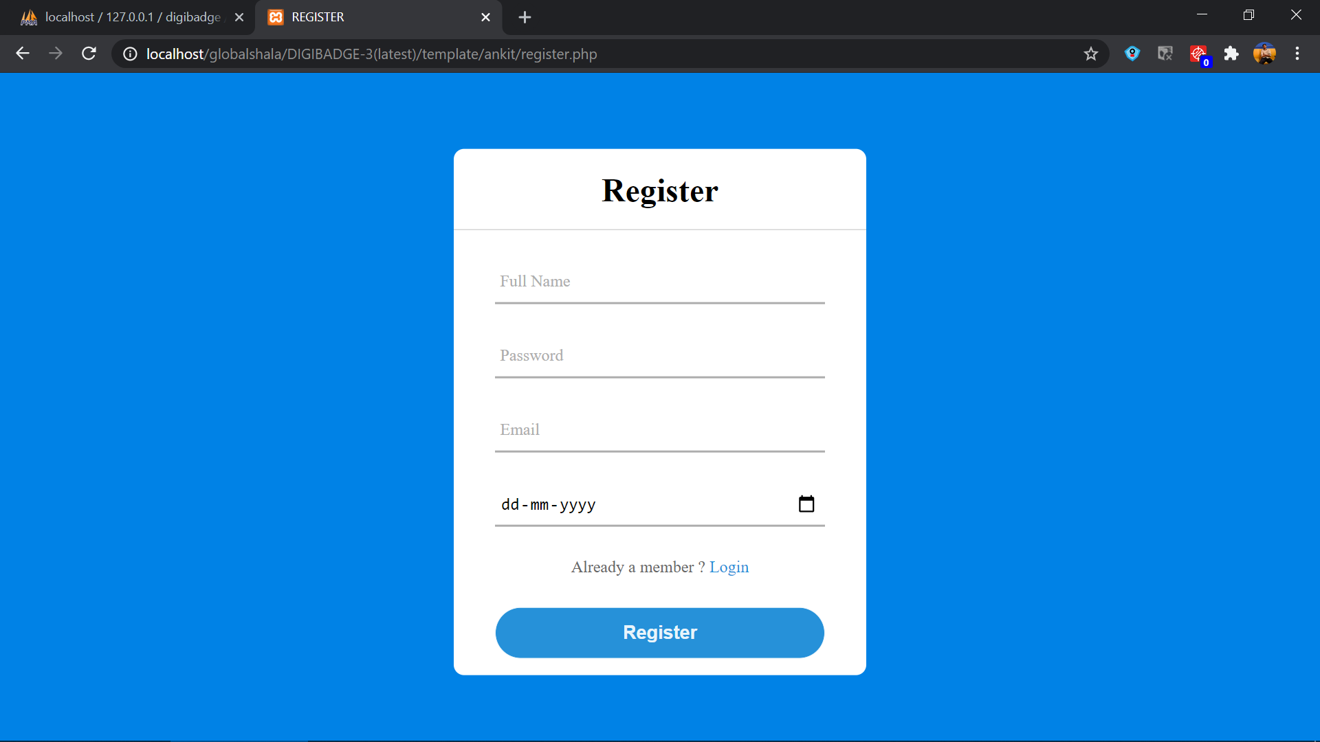
SIGN-UP / SIGN-IN PAGE
This is the prototype of the sign-up and sign-in page of the DIGIBADGE

Slide 12
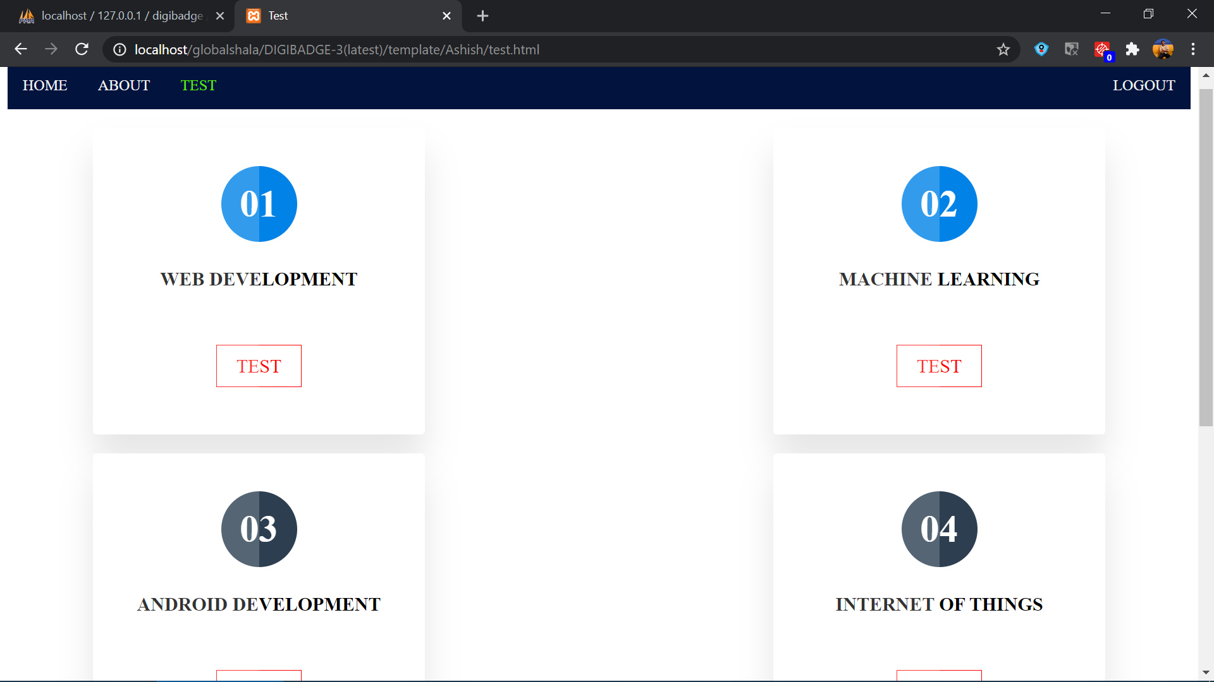
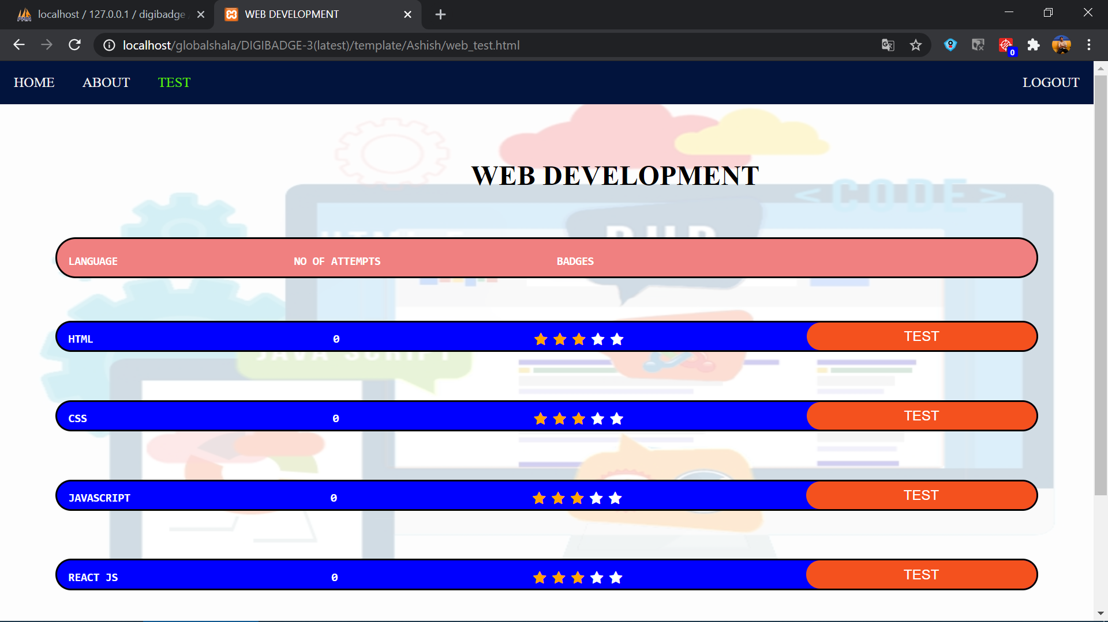
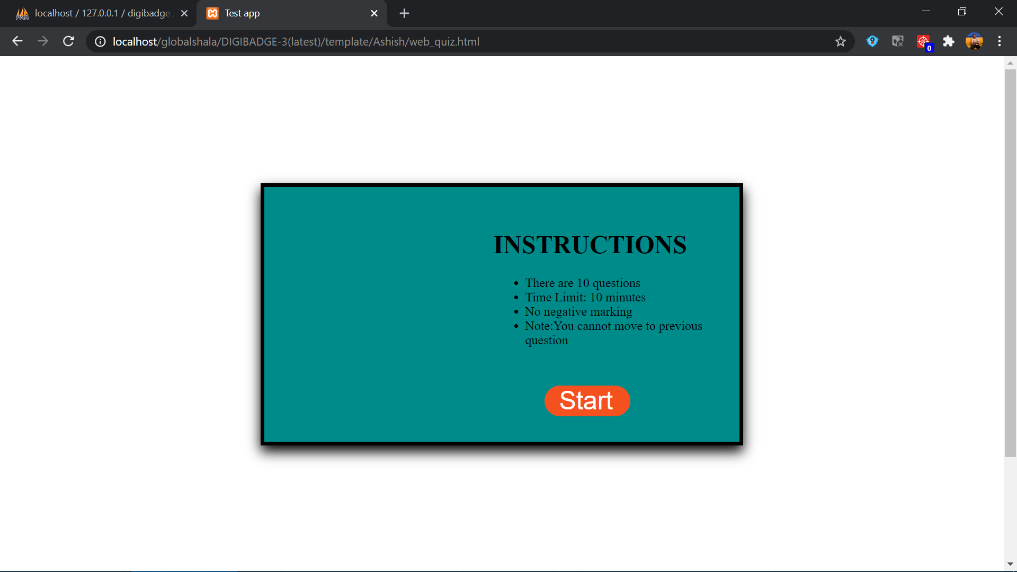
TEST PAGE
This the first page of test section which contains
all different fields in which test can be taken.It
also contains the highest badge (top right side)
which user has obtained in the given field.

Slide 13
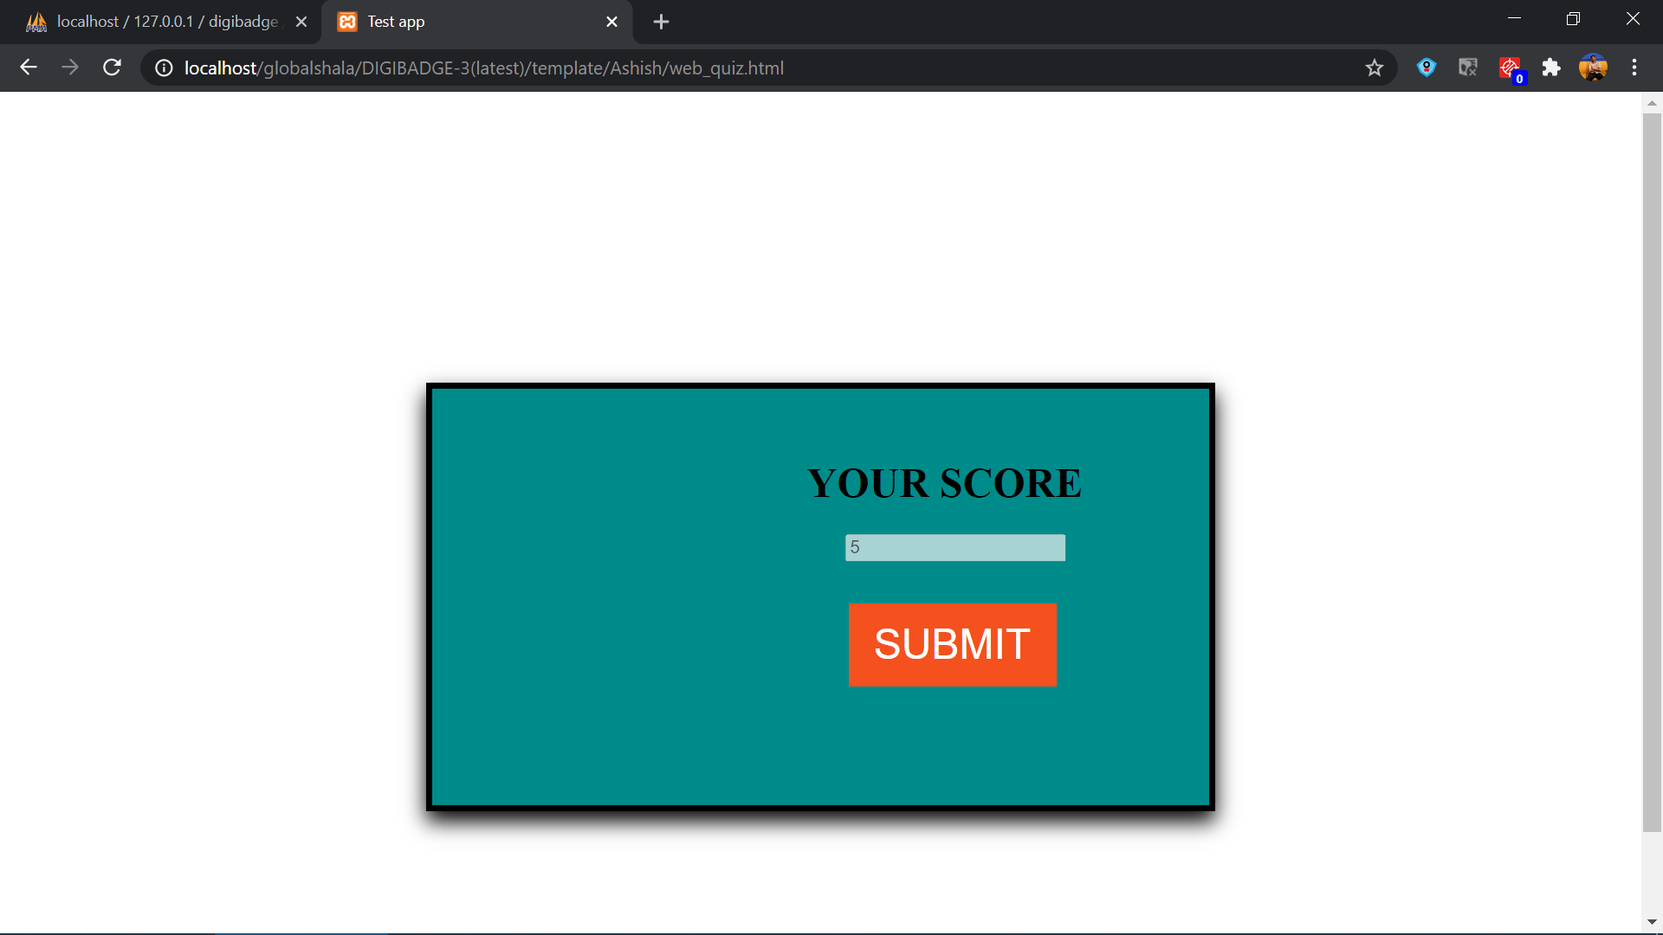
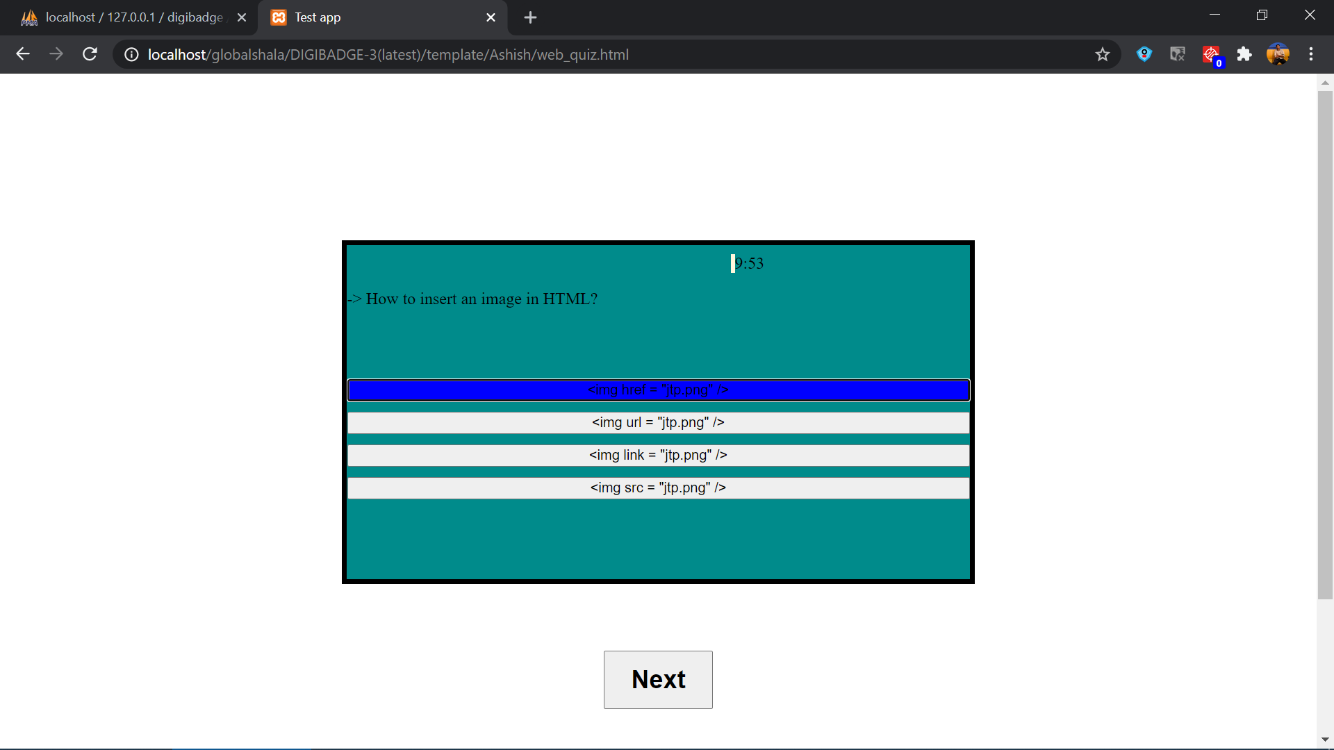
MCQ TEST PAGE
This the part of test page which contains the language ,framework in which the test for particular domain can be taken.It also contains the no of attempts and badges taken for particular language ,framework. (The following slides will show how the subsection are to be made for other domains).

Slide 14
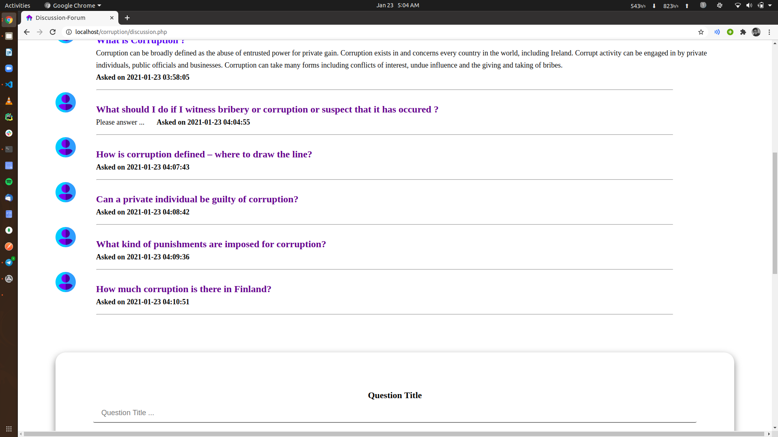
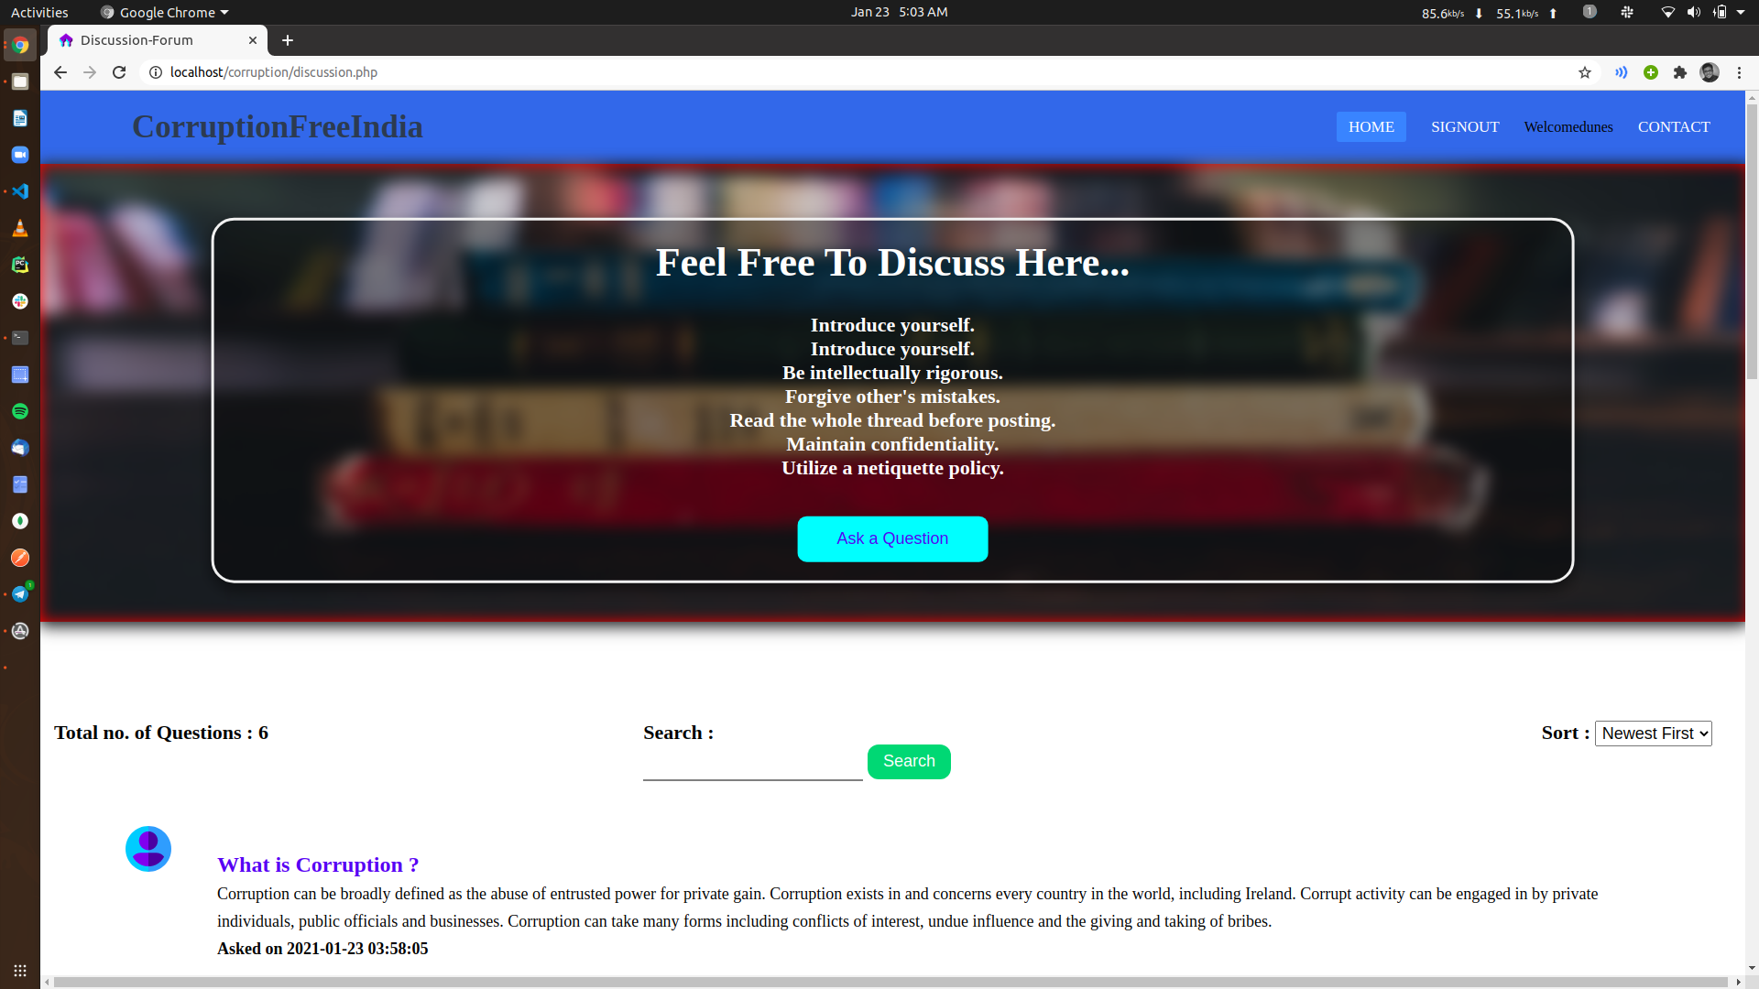
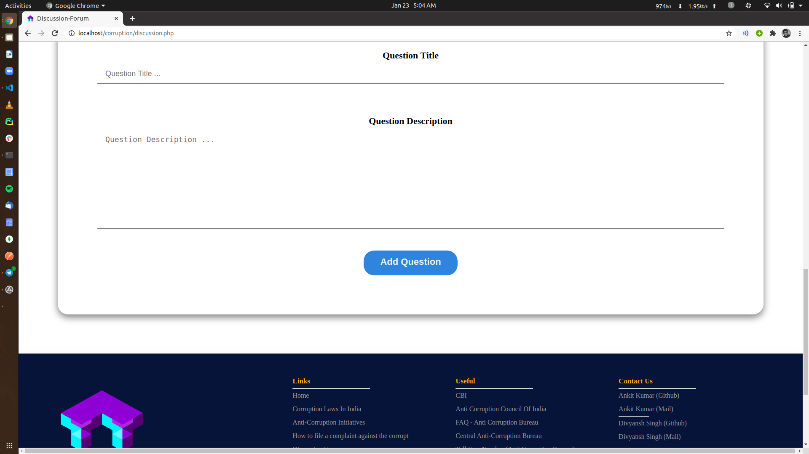
DISCUSSION FORUM

Slide 15
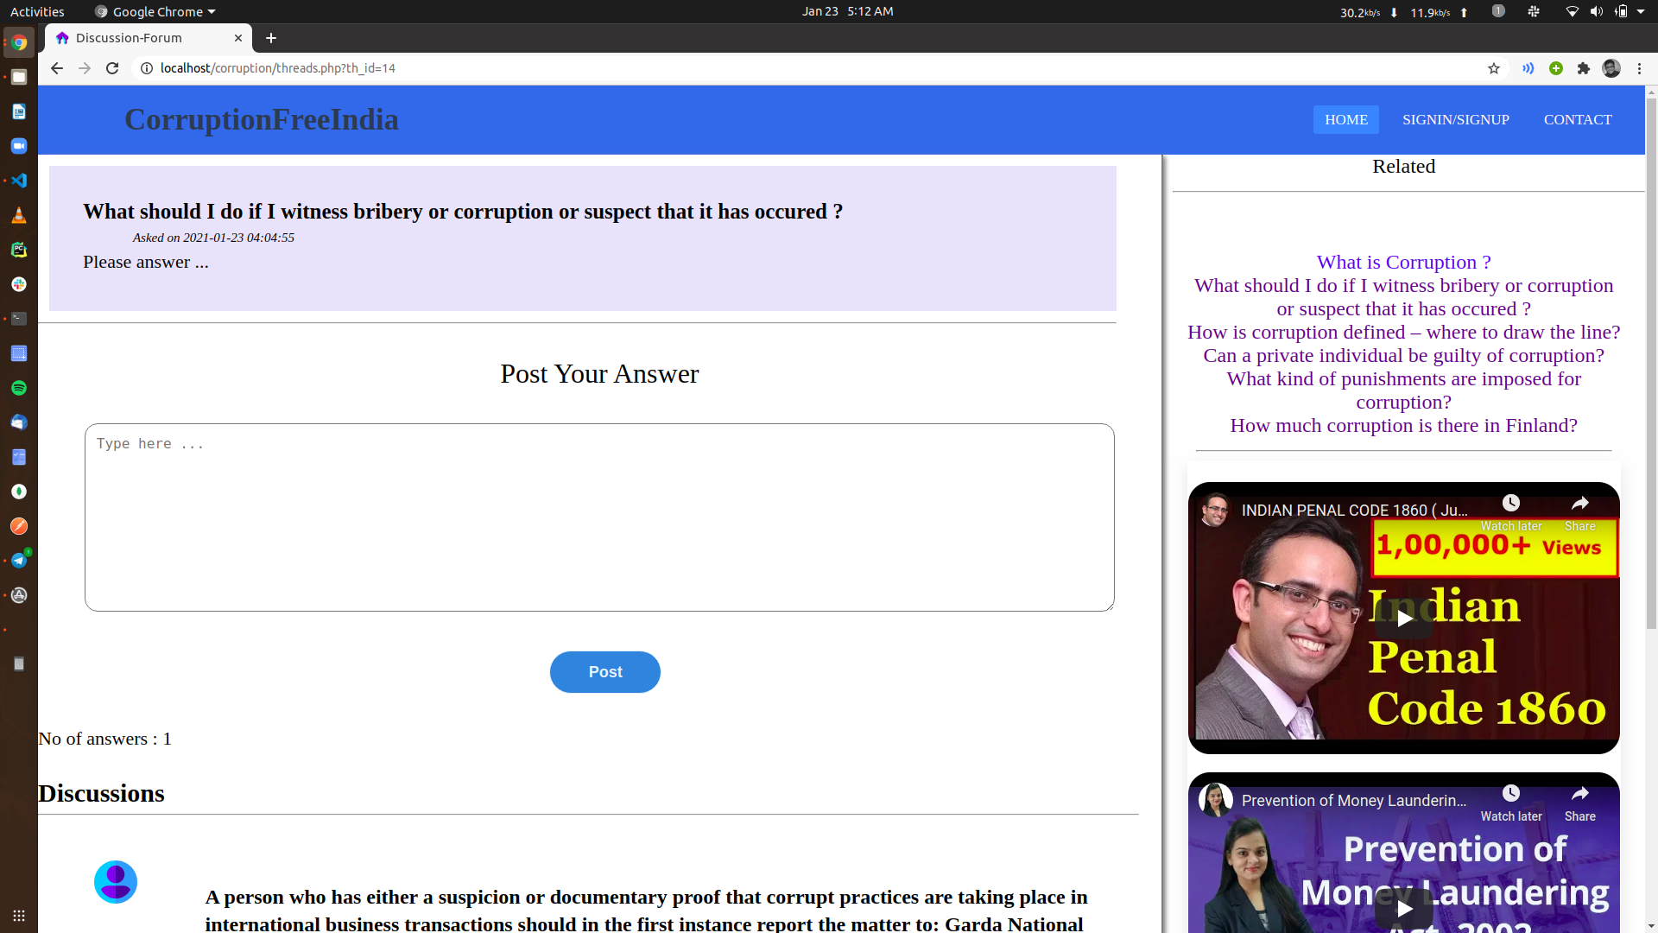
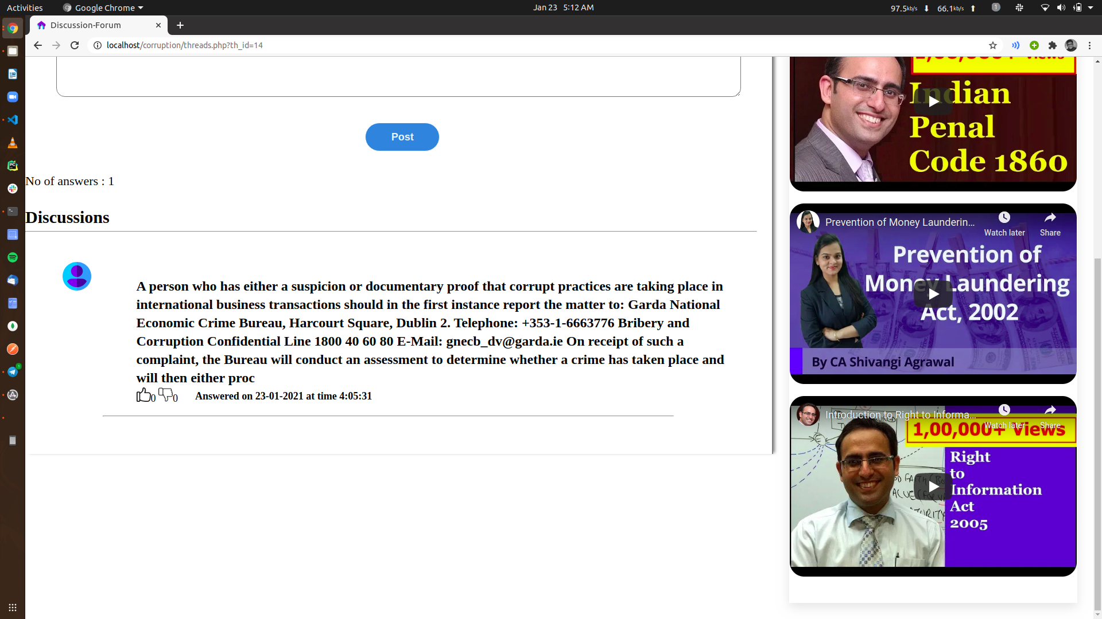
POST COMMENT ON A THREAD

Slide 16
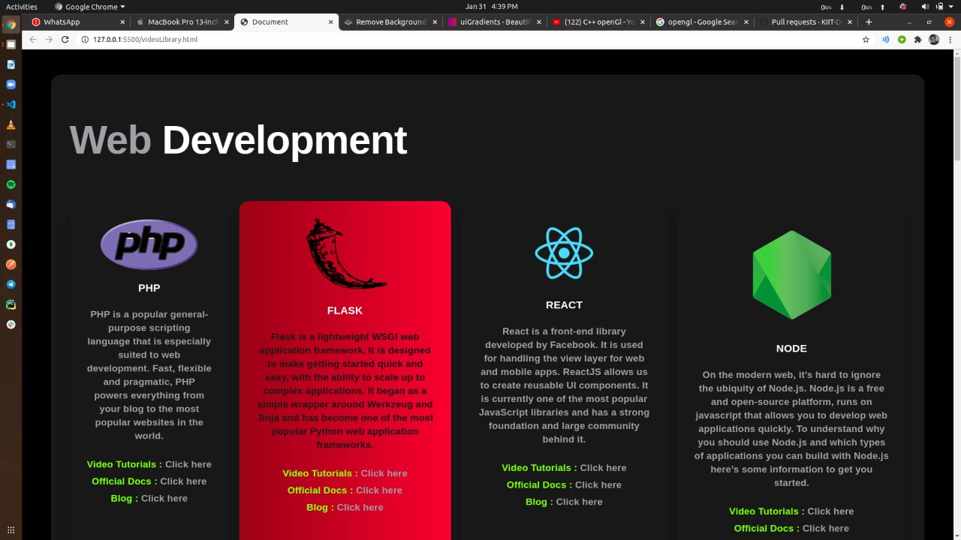
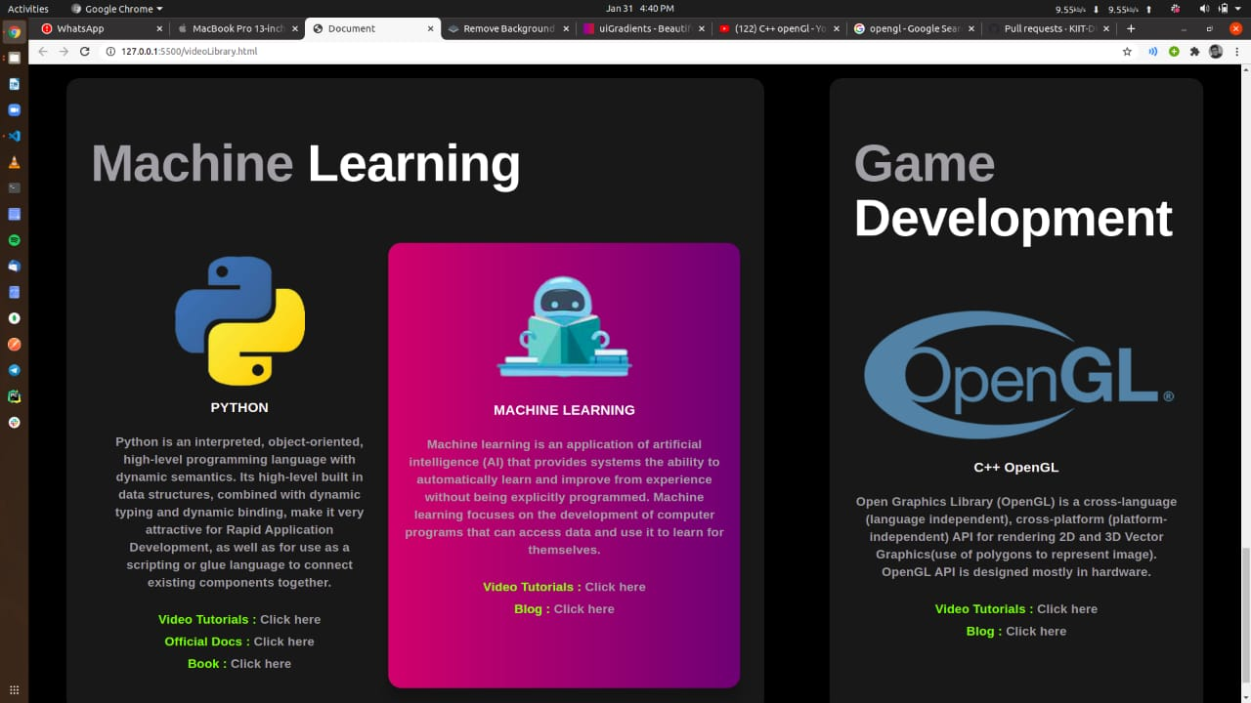
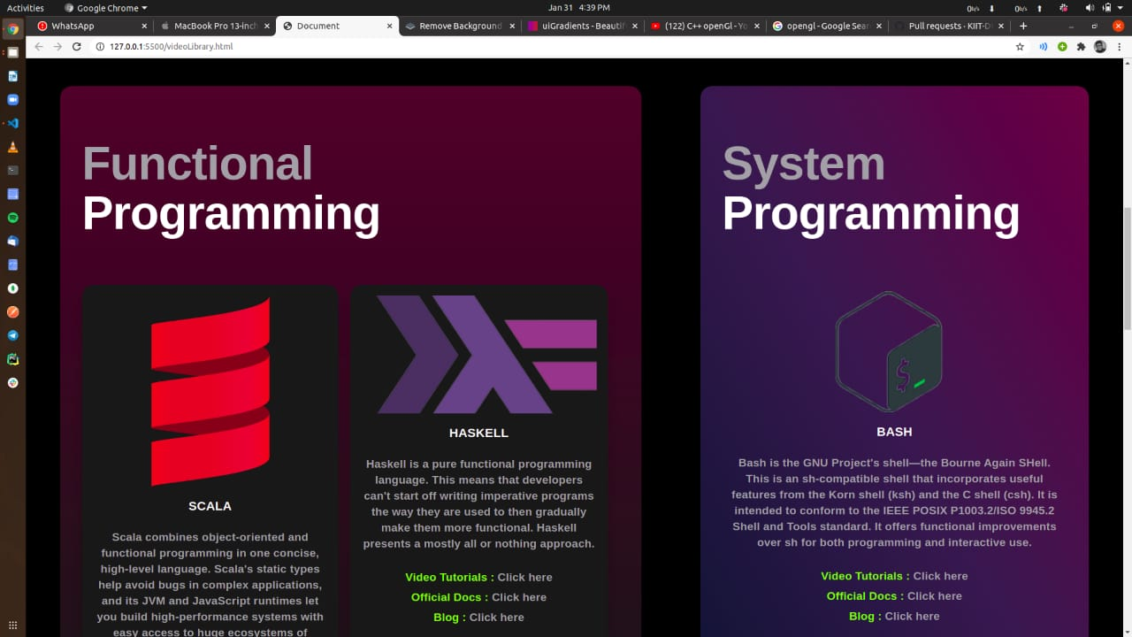
E-Learning and Blogs
This page consist most popular e- learning content about different latest technologies and also blogs related to it

Slide 17
FUTURE SCOPE
Security can be implemented in future to prevent any unfair means in test.
Link sharing options can be added later so that user can share their badges in their social profiles.
Website can be made asynchronous using AJAX and JQUERY.
Skill identification can be later added to recognise skills from the CV/Resume uploaded.
This platform can be converted to a Learning Management System

Slide 18
THANK YOU

